Slide 1
Topic : Trigonometry
EQ: What is the sine ratio and how can I apply it to right angled triangle ?

Slide 2
Mental Maths
If you are given the two sides of a right angled triangle that are not the hypotenuse, which trig function should you use ?
What is the symbol for the Greek letter alpha ?

Slide 3
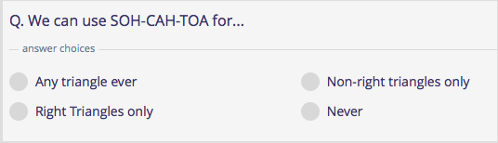
Mental Maths
Write a equation to represent the pythagorean theorem ?
We can use SOH-CAH_TOA for..

Slide 4
Real life applications of trigonometry
The angle of direction and its length can be calculated to make tunnels started at opposite sides of a mountain meet at a centre.
Landscape surveyors often use trigonometry to assess the height of trees and buildings.

Slide 5
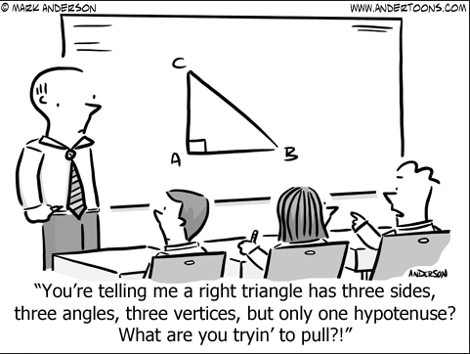
Cartoon

Slide 6

The sine Ratio for finding an angle

Slide 7

What is the sine ratio?

Slide 8
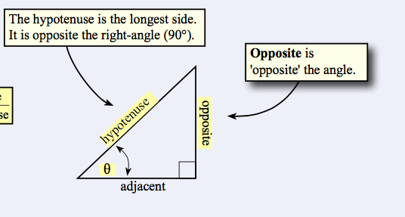
For example

Slide 9
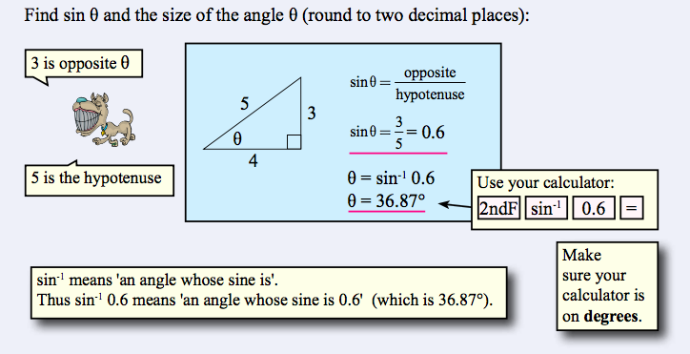
For example

Slide 10
The Sine Ratio examples
Now complete exercise 17.3 page 232 in the Dwyer Textbook Q1-6.
Please draw and label each triangle in your textbook.

